Slide 1
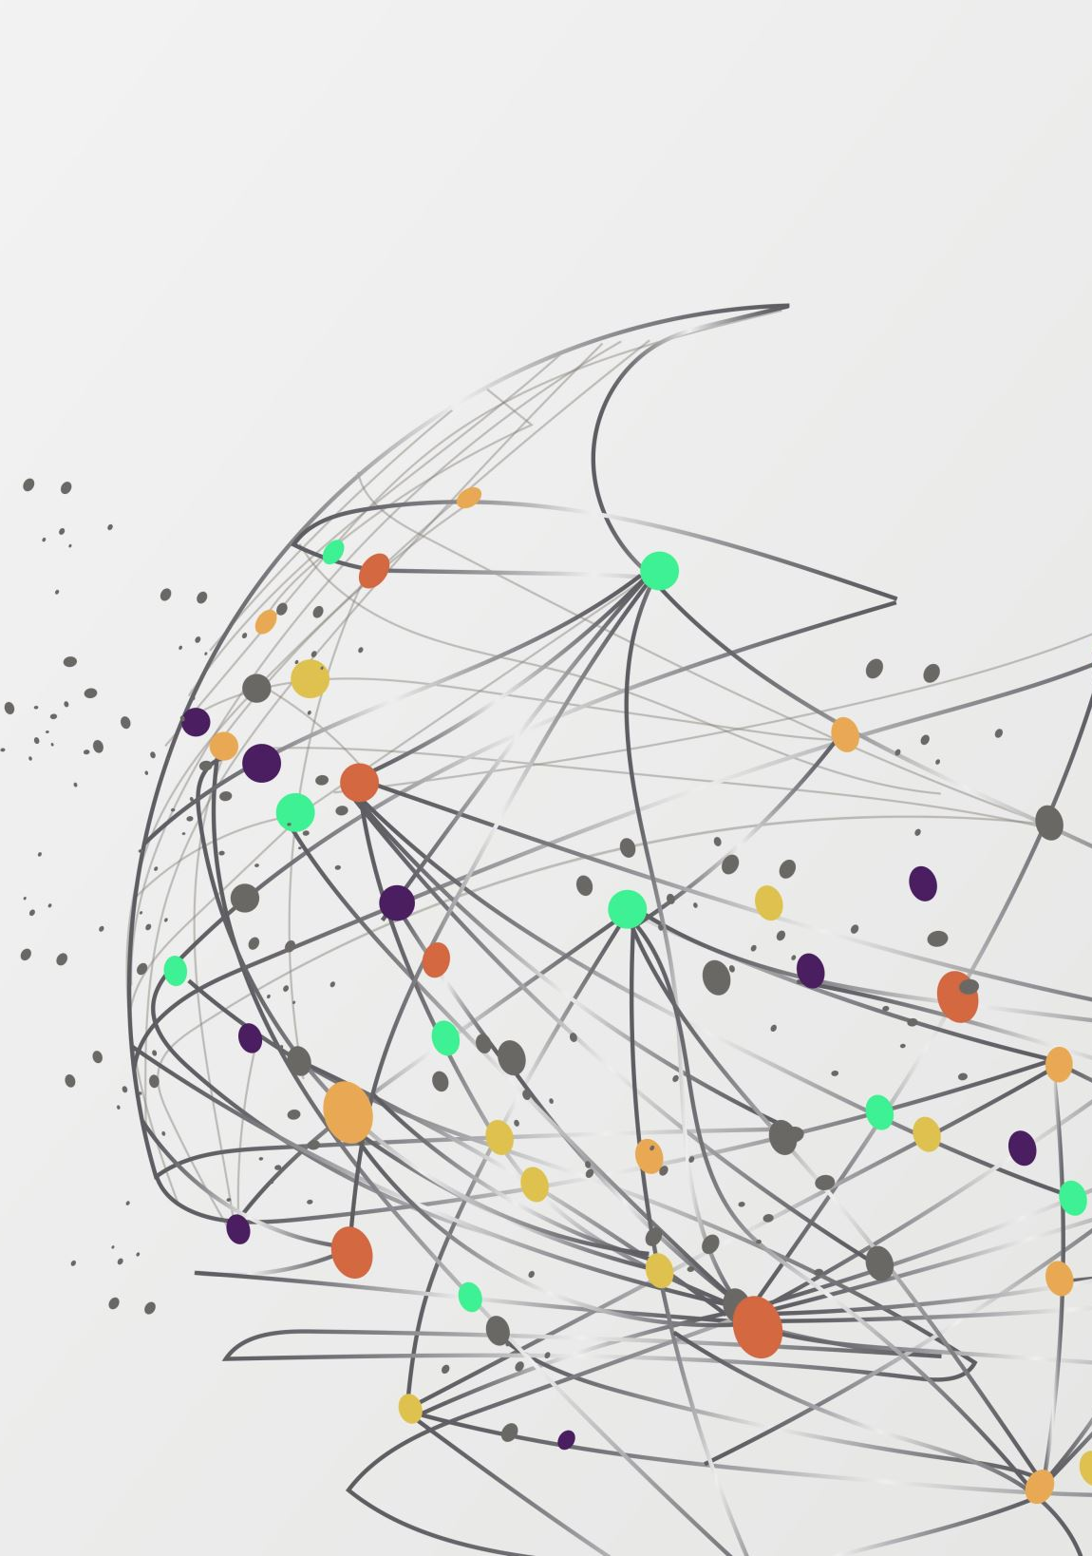
HUMAN POPULATION &SOCIAL ISSUES
SUBMITTED BY- RUPALLI DEVI
URN-2104172
CRN-2115119
CSE B2

Slide 2
HUMAN POPULATION AND THE ENVIRONMENT
In this presentation, we will be discussing the important topics related to human population and the environment. We will cover the following areas:
• Population growth and variation among nations
• Population explosion and family welfare programs
• Environment and human health
• Human rights and value education
• HIV/AIDS
• Women and child welfare

Slide 3
Population growth and variation among nations
• The human population has been growing at an alarming rate in recent years. As of 2021, the global population is around 7.9 billion, and it is estimated to reach 9.7 billion by 2050. The rate of population growth varies significantly among nations. Some countries, such as Japan and some European nations, have declining populations due to lower birth rates and aging populations. In contrast, some developing nations, such as India and Nigeria, have high population growth rates due to high fertility rates.
• The rapid growth of human populations can have significant impacts on the environment, including increased pressure on natural resources, pollution, and habitat loss. It is essential to promote sustainable population growth to ensure that we can meet the needs of current and future generations while protecting our planet

Slide 4
Population explosion and family welfare programs
• The term population explosion refers to a sudden increase in the human population due to high birth rates and reduced mortality rates. The phenomenon can have significant consequences for the environment and human health, such as increased pressure on natural resources and the spread of diseases.
• Family welfare programs aim to address the issue of population explosion by providing education, counseling, and access to family planning services. These programs have been successful in reducing fertility rates in some regions. However, there are still many barriers to accessing these services, including cultural and social norms, lack of resources, and inadequate infrastructure

Slide 5
Environment and human health
• The environment plays a critical role in human health. The air we breathe, the water we drink, and the food we eat all come from the environment. However, human activities such as deforestation, pollution, and climate change have had significant negative impacts on the environment, which, in turn, can affect human health.
• Air pollution, for example, can cause respiratory diseases such as asthma and lung cancer. Water pollution can lead to gastrointestinal diseases such as cholera and typhoid fever. Climate change can also exacerbate health problems, such as heat stress, malnutrition, and the spread of vector-borne diseases like malaria

Slide 6
Human rights and value education
• Human rights are fundamental to human dignity and well-being. They include the right to life, liberty, and security, among others. However, many individuals and communities around the world face human rights violations, including discrimination, violence, and exploitation.
• Value education is a crucial tool for promoting human rights and dignity. It involves teaching values such as respect, empathy, and responsibility to help individuals develop a strong sense of morality and ethics. By promoting values such as inclusivity and equality, we can work towards a world where human rights are respected and protected

Slide 7
HIV/AIDS
• HIV/AIDS is a global health issue that has affected millions of people worldwide. The disease is caused by the human immunodeficiency virus (HIV), which attacks the immune system, making individuals vulnerable to infections and other illnesses.
• The impact of HIV/AIDS extends beyond health, affecting social and economic development. The disease disproportionately affects marginalized communities, such as sex workers and men who have sex with men. There are significant challenges in preventing and treating HIV/AIDS, including social stigma, lack of access to healthcare, and inadequate funding for research.

Slide 8
Women and child welfare
• Women and Child Welfare is a broad term that refers to the wellbeing of women and children. It includes various aspects such as health, education, nutrition, safety, and protection from violence. The Indian Government has a separate ministry called the Ministry of Women And Child Development that is responsible for the welfare of women and children in Indian

Slide 9
Conclusion
In conclusion, the human population and the environment are interconnected, and the relationship between the two is complex. While the population growth rate varies among nations, it is essential to adopt sustainable practices that minimize the impact of human activities on the environment. Addressing environmental challenges requires a multifaceted approach that includes education, policies, and sustainable practices. Protecting the environment is not just about preserving natural resources but also about promoting the welfare of the human population, especially the most vulnerable. Thank you for your attention

Slide 10


